Slide 1
Information system

Slide 2
Information systems development
Controls the Department of Information Systems in part to information technology; which are developed and used and their applications, and their impact on the business .

Slide 3
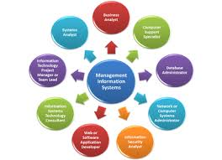
MIS professionals create information systems for data management (i.e., storing, searching and analyzing data).

Slide 4
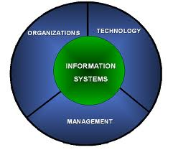
Information system
Components
However, programming is just a small part of the MIS curriculum. While programming concepts represent some of the founding concepts and information systems development, implementation and use, many jobs in MIS do not utilize programming at all.

